Slide 1
Melbourne Coding Club Game Programming Part 3
Presenter: Tabish Sarfraz

Slide 2
Intro
Sprites
Collision detection
Boundary detection
Bullet shooting

Slide 3

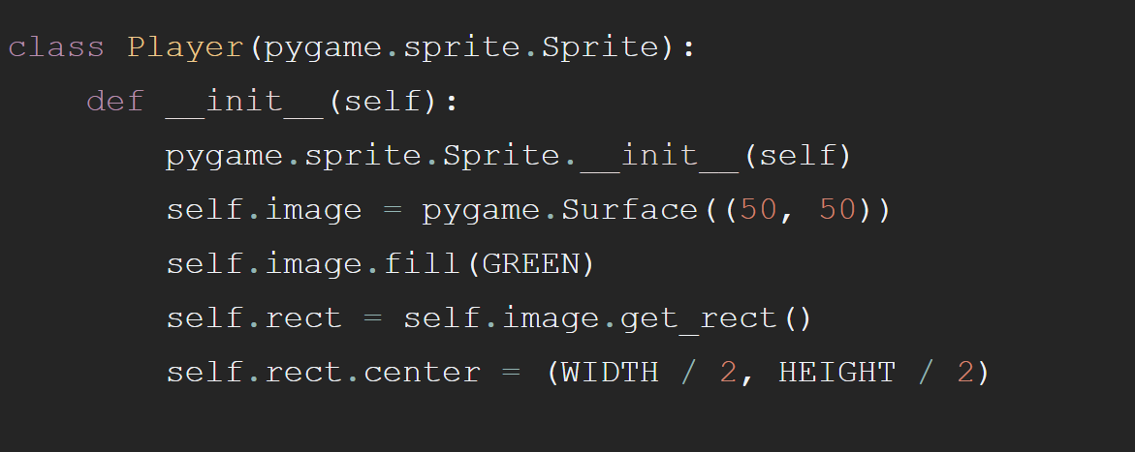
Sprite
Any Graphic object that moves on screen
Draw sprites on the surface window

Slide 4
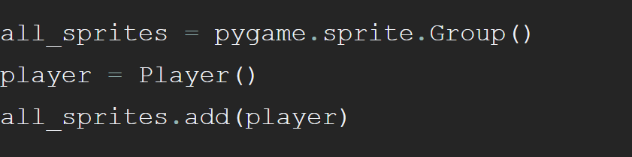
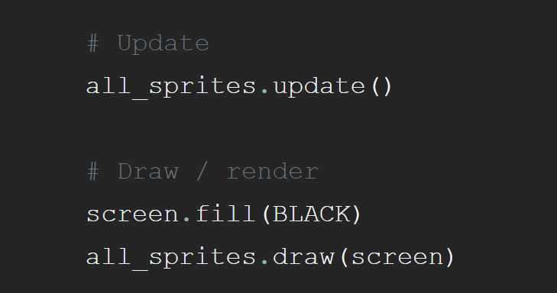
Sprite

Slide 5
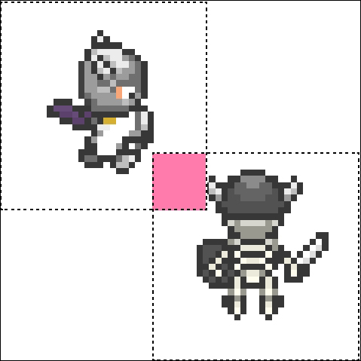
Collision Detection
Collide a sprite with a sprite group pygame.sprite.spritecollide()
Collide group of sprite with another group pygame.sprite.groupcollide()

Slide 6
Sprite Collision
spritecollide(sprite, group, dokill, collided) dokill is a Boolean collided is a callback function used to calculate if collision occurred if collided is not used all sprites should have rect value

Slide 7
Group Collision
groupcollide(group1, group2, dokill1, dokill2, collided)

Slide 8
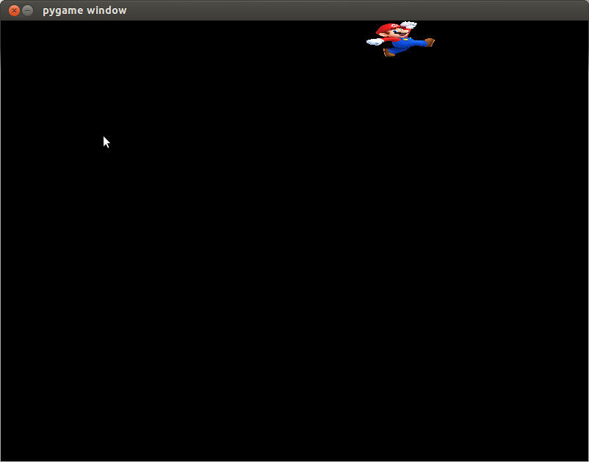

Boundary Detection
Use clamp_ip() from rect
Moves a rectangle within another rectangle
Use window surface as boundary and compare with player object

Slide 9
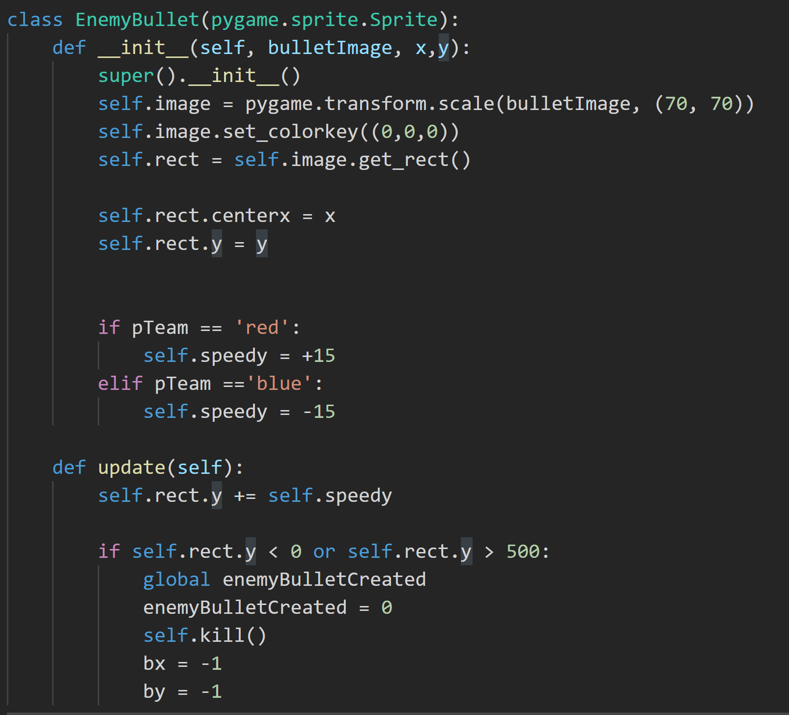
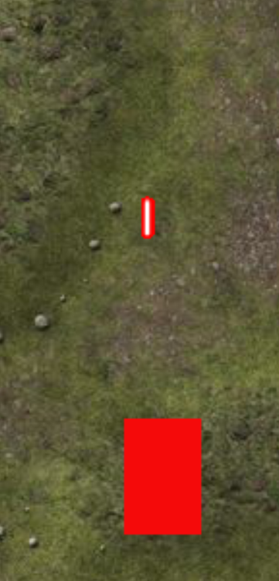
Bullet Shooting

Slide 10
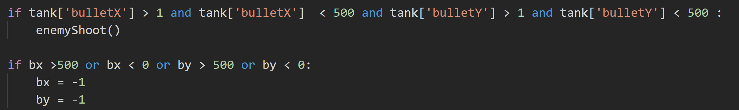
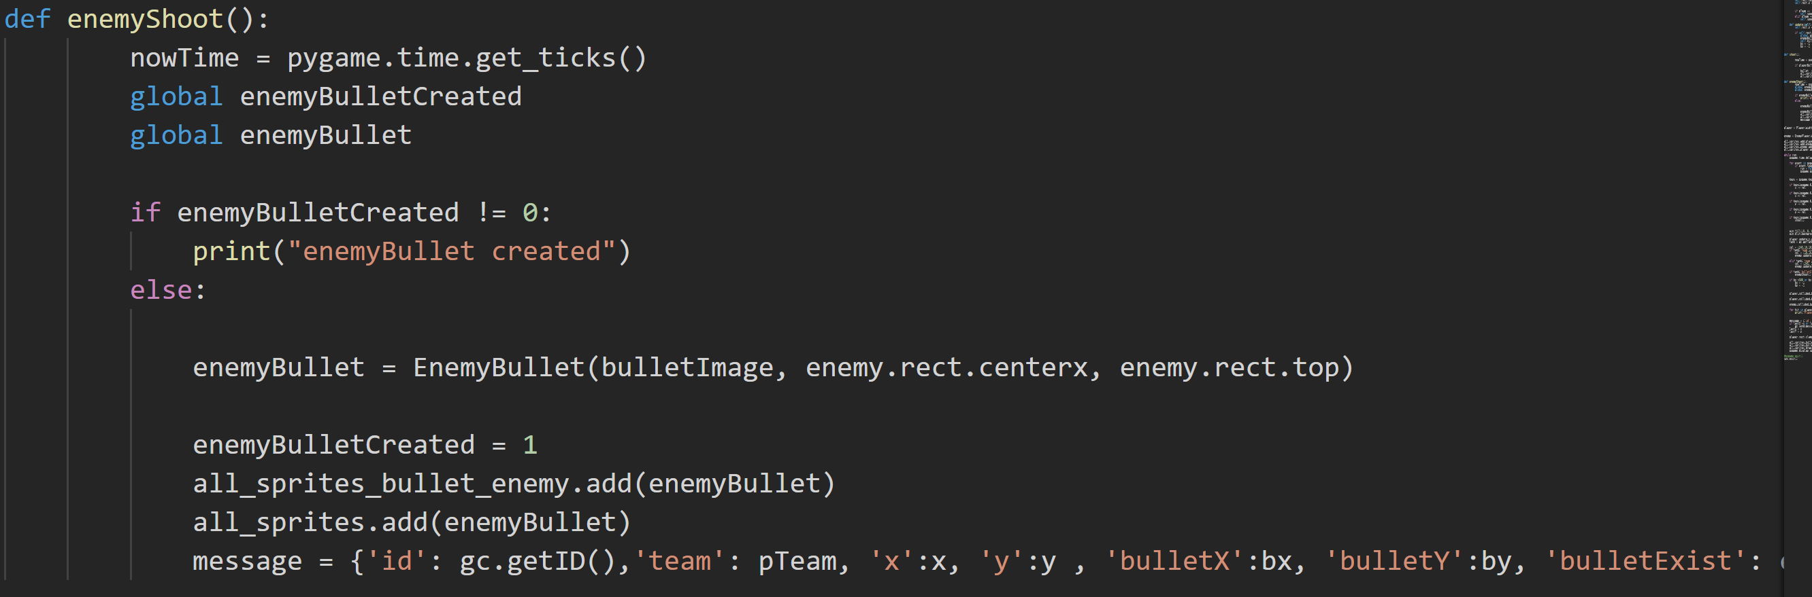
Bullet Shooting

Slide 11
Demonstration
https://github.com/TabishSarfraz/melbournecodingclub

